Slide 1

Interactive Population Visualization of Virginia Using VTK and
Vega-Lite in Trame
Jayachandra Sarika, Anjani Kumar Avadhanam, Minh Nguyen
University of Houston
COSC 6344 - Fall 2025
Prof. Guoning Chen

Slide 2
Contents
Project Overview
Live Demo
Dataset
Q & A
Methodology / System Architecture
01
04
02
05
03
Company Name

Slide 3

Project Overview
Built an interactive system to explore Virginia’s population data (2010 - 2019) through spatial and analytical visualizations.
Combined VTK for maps and Vega-Lite / Altair for charts, all connected using the Trame web framework.
Enabled real-time updates, where selecting a county instantly refreshes all linked visual views.

Slide 4

Dataset
Used Virginia county-level population data from 2010–2019 (133 counties).
Data stored in CSV containing yearly population columns (2010–2019).
VTK file constructed using Virginia public shapefiles (using pyshp library)
Geographic boundaries loaded from a VTK polygon mesh containing county shapes.
Preprocessing included name normalization + linking CSV rows to VTK polygon cells.
Notes:
Why Virginia? - Virginia is the third most counties count state - which we thought it can make a pretty good balance to do the visualization and analysis on county data.

Slide 5
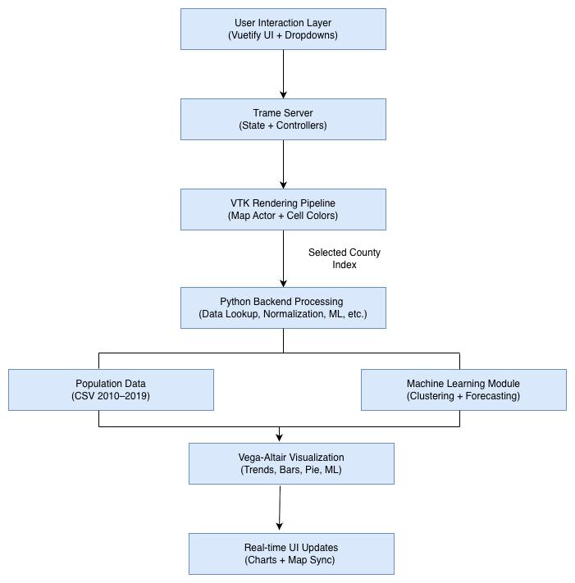
System Architecture
Combines VTK for geographic rendering, Vega-Lite for analytical charts, and Trame for linking everything in a single web interface.
Uses a reactive state model, where any change (county selection, tab switch, slider) updates all views instantly.
A backend layer handles data loading, preprocessing, clustering, and forecasting, while the frontend displays synchronized visual outputs.
VTK map and Vega-Lite charts communicate through Trame event callbacks, ensuring real-time, coordinated multi-view updates

Slide 6





Methodology / Tech stack
Loaded and integrated CSV (population) + VTK mesh (map) into a unified structure.
Built VTK pipeline for map coloring, highlighting, and interactive selection.
Created Vega-Lite charts: trend lines, yearly bars, growth gauge, similarity bars, correlation heatmap.
Implemented reactive state updates to synchronize map + charts in real time with Trame.
ML clustering / forecasting with Pandas, Numpy, Scikit-learn.
Notes:
VTK → High-performance rendering of Virginia’s geographic map.
Vega-Lite / Altair → Interactive charts for trends, growth, similarity, forecasting.
Trame → Connects VTK + Vega-Lite using reactive state-based web interface.
Python (Pandas, NumPy, Scikit-learn) → Data processing, clustering, forecasting

Slide 7
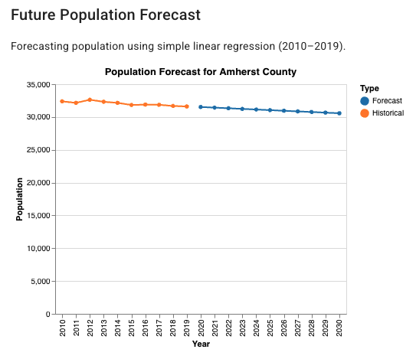
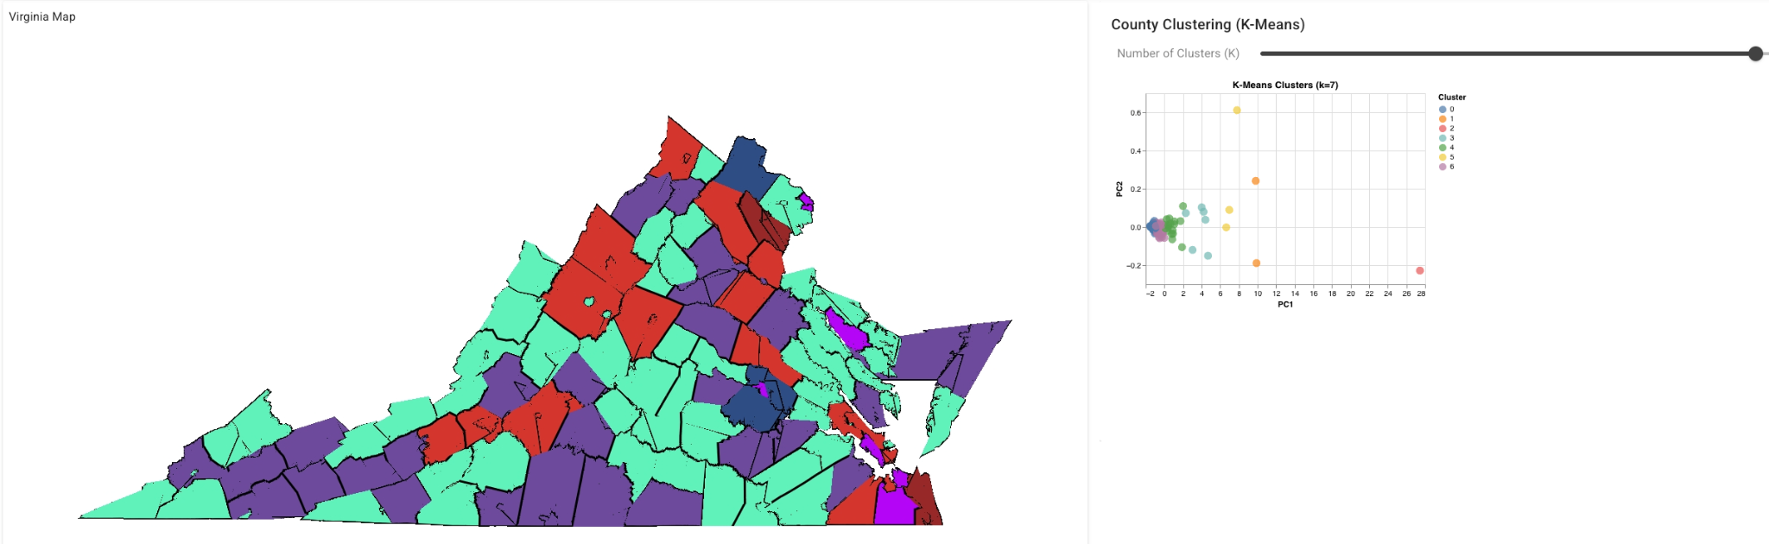
Machine Learning Components (extra exploration)
Linear regression used for forecasting county populations up to 2030.
K-Means clustering on normalized 10-year population vectors to group similar counties.
Used PCA to visualize clusters in 2D for interpretability.
All ML results dynamically update based on user selections.

Slide 8
Visualizations Implemented
Population trend line
Mini bar chart (2010 vs 2019)
Similarity ranking
Growth gauge
Pie chart
Correlation heatmap
Forecast chart
Clustering view

Slide 9
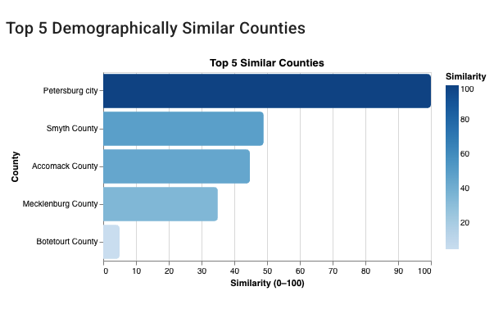
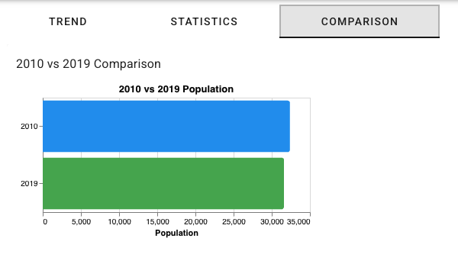
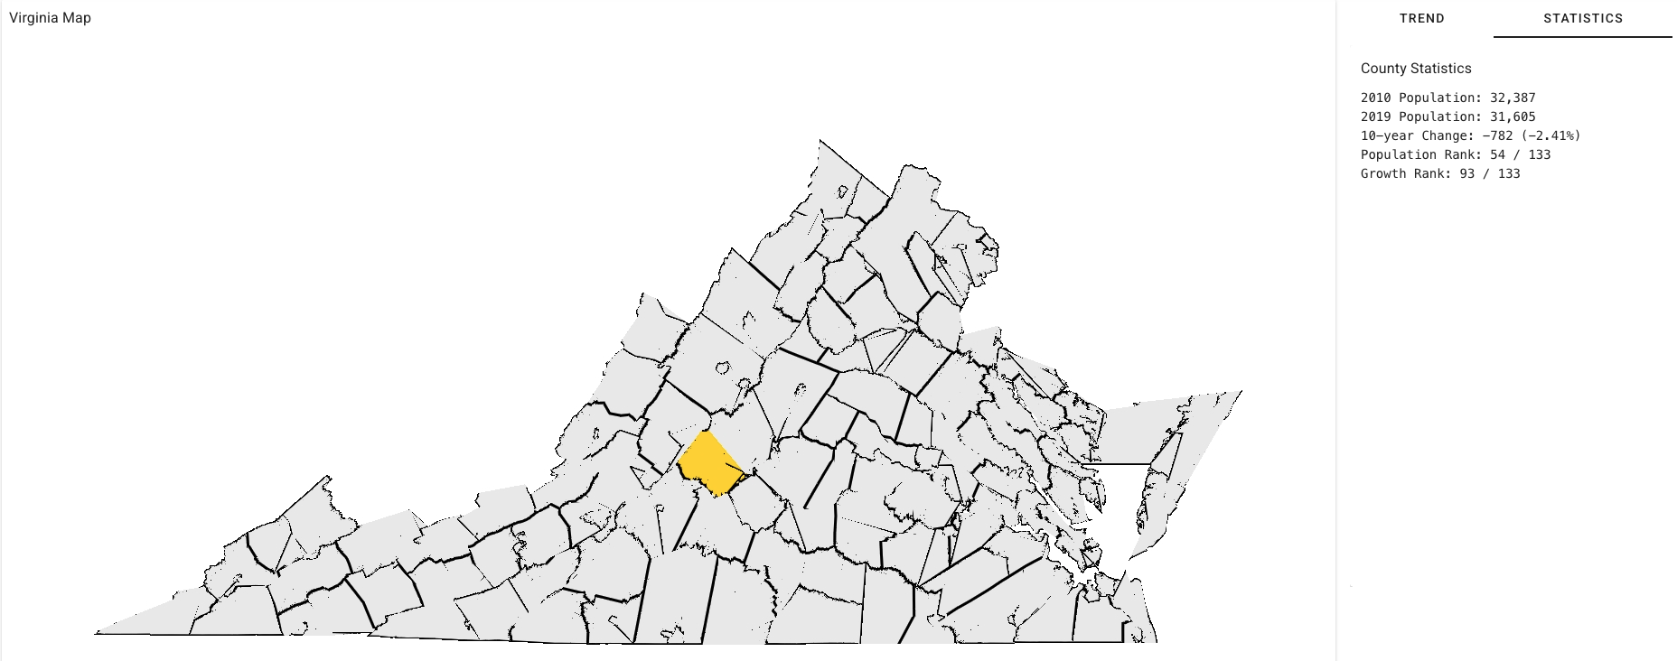
Results

Slide 10
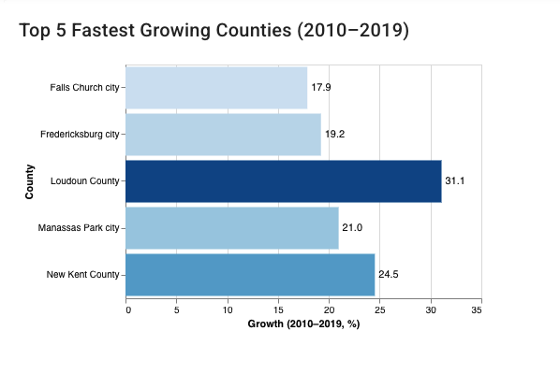
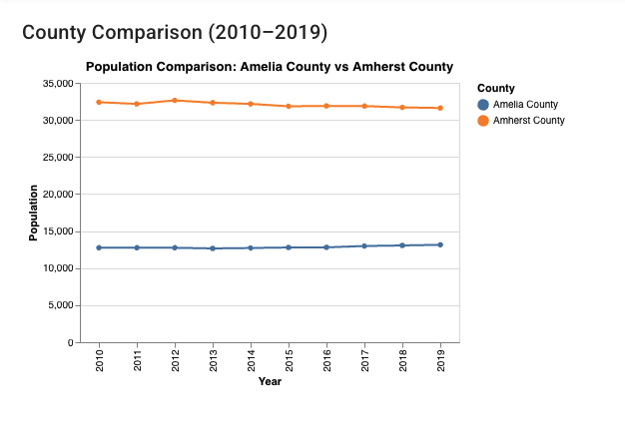
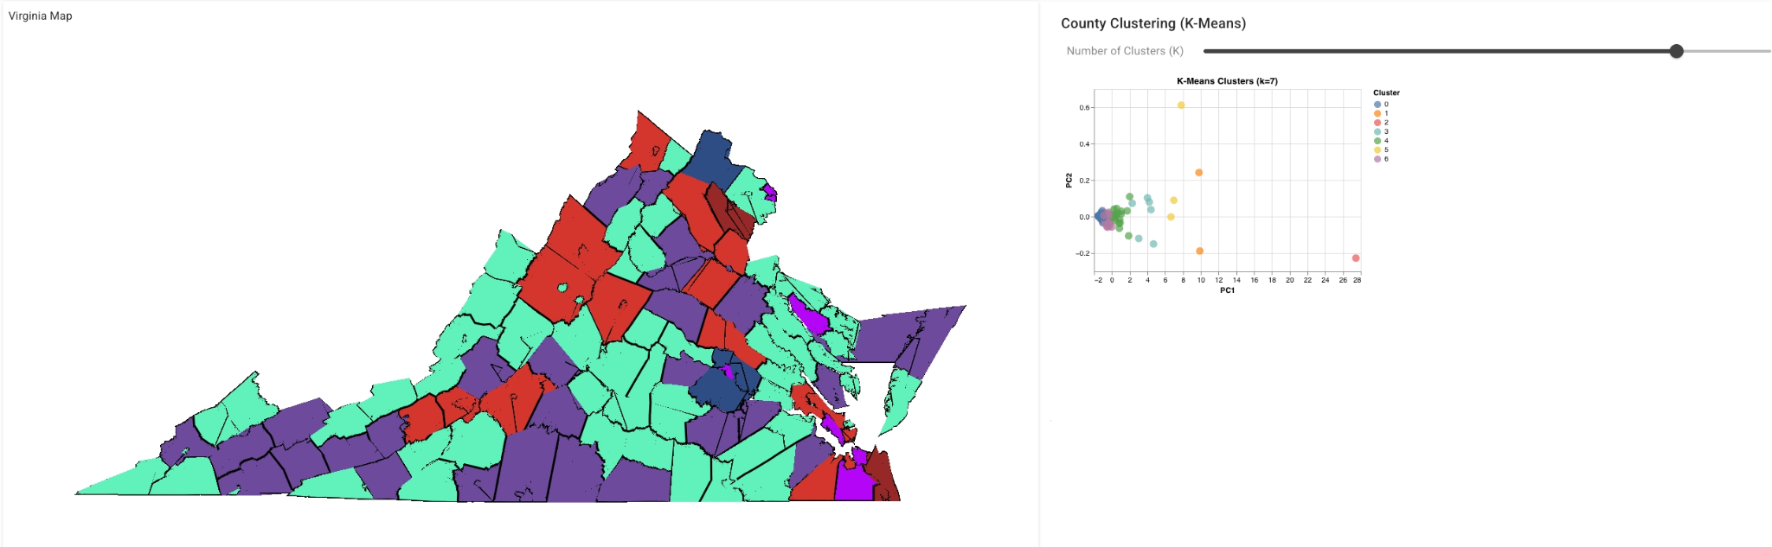
Results
and more …

Slide 11

Any questions?
Ask away!
Let's discuss any doubts or concerns.

Slide 12

Demo

